Slide 1
A Whirlwind Tour of PIN Diodes
Nick Cardamone – Fall 2023 – Nonlinear Microwave Devices
(and Circuit Theory 1 Tutorial)

Slide 2
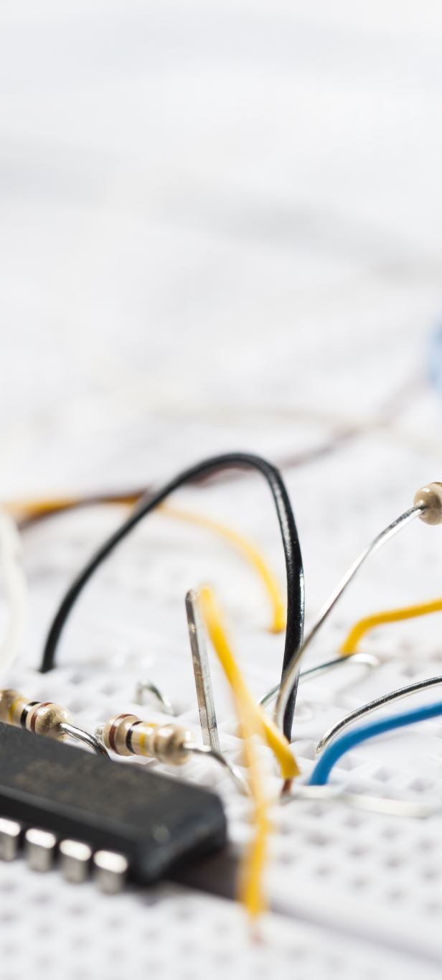
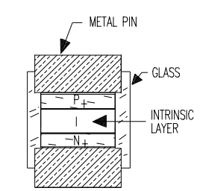
Overview – Applications of PIN Diodes
What is a diode?
Diode Models – DC/ Low Frequency, High Frequency
PIN Diode Overview + Model
PIN Diode Switches
PIN Diode Attenuators
PIN Diode Modulators
PIN Diode Phase Shifters
PIN Diode Detectors

Slide 3
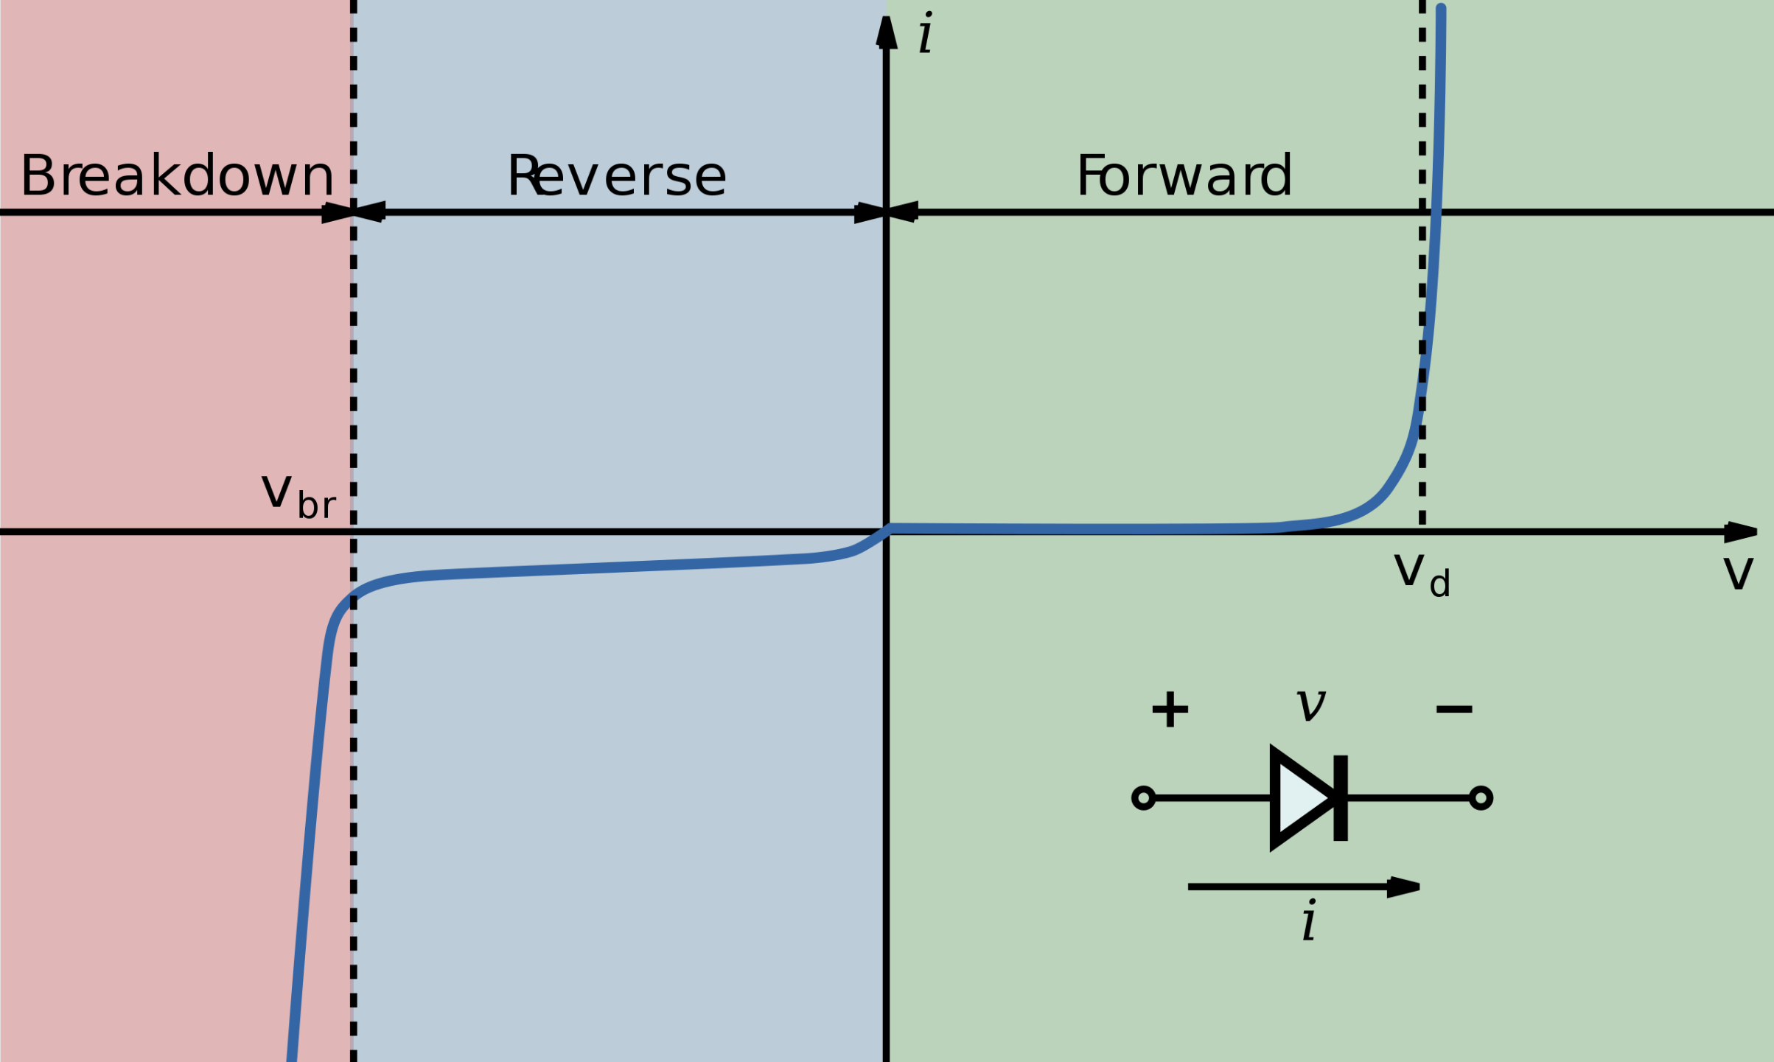
What is a Diode?
2 Terminal Non-Linear Device
Only allows DC current to flow in 1 direction
Symbol looks similar to an arrow
The current is supposed to flow in the direction of the arrow

Slide 4
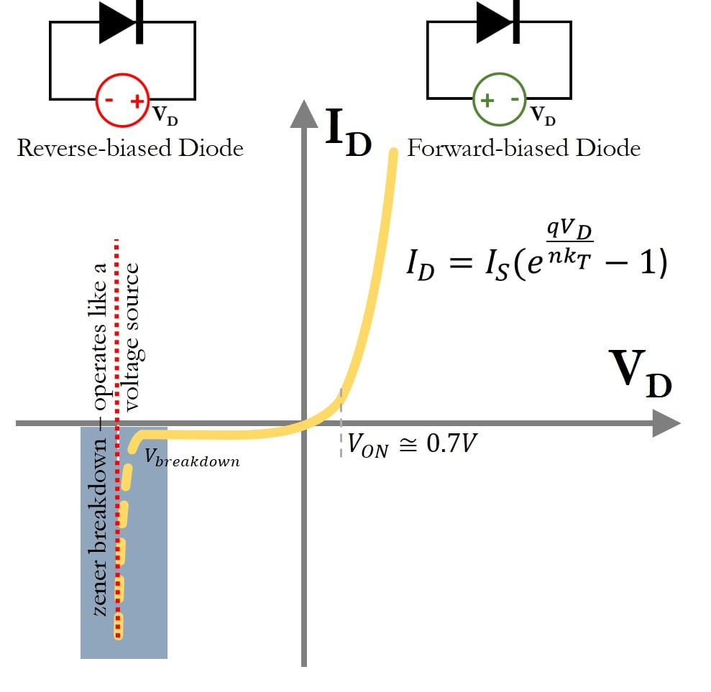
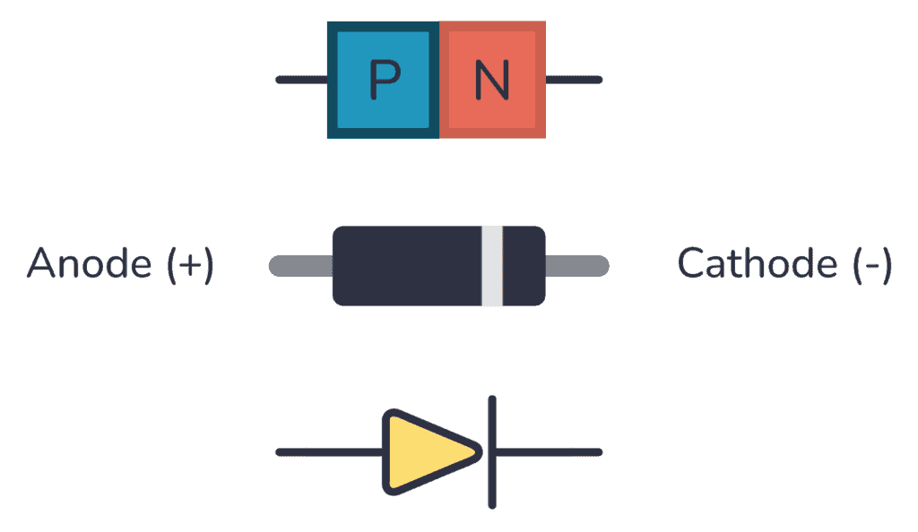
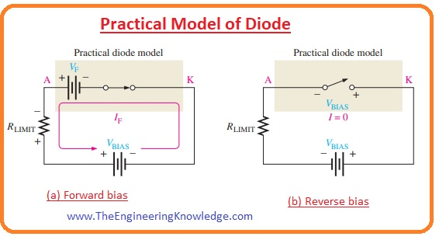
Diode Modeling (Low Frequency/ DC)
A Diode acts like a voltage controlled switch
If the DC voltage supplied to the diode is sufficiently positive the diode acts as a short circuit (forward bias)
If the DC voltage supplied to the diode is negative the diode acts like an open circuit (reverse bias)
The DV voltage supplied to the diode is called the bias voltage
In forward bias, the DC voltage across the diode will be constant regardless of the current

Slide 5
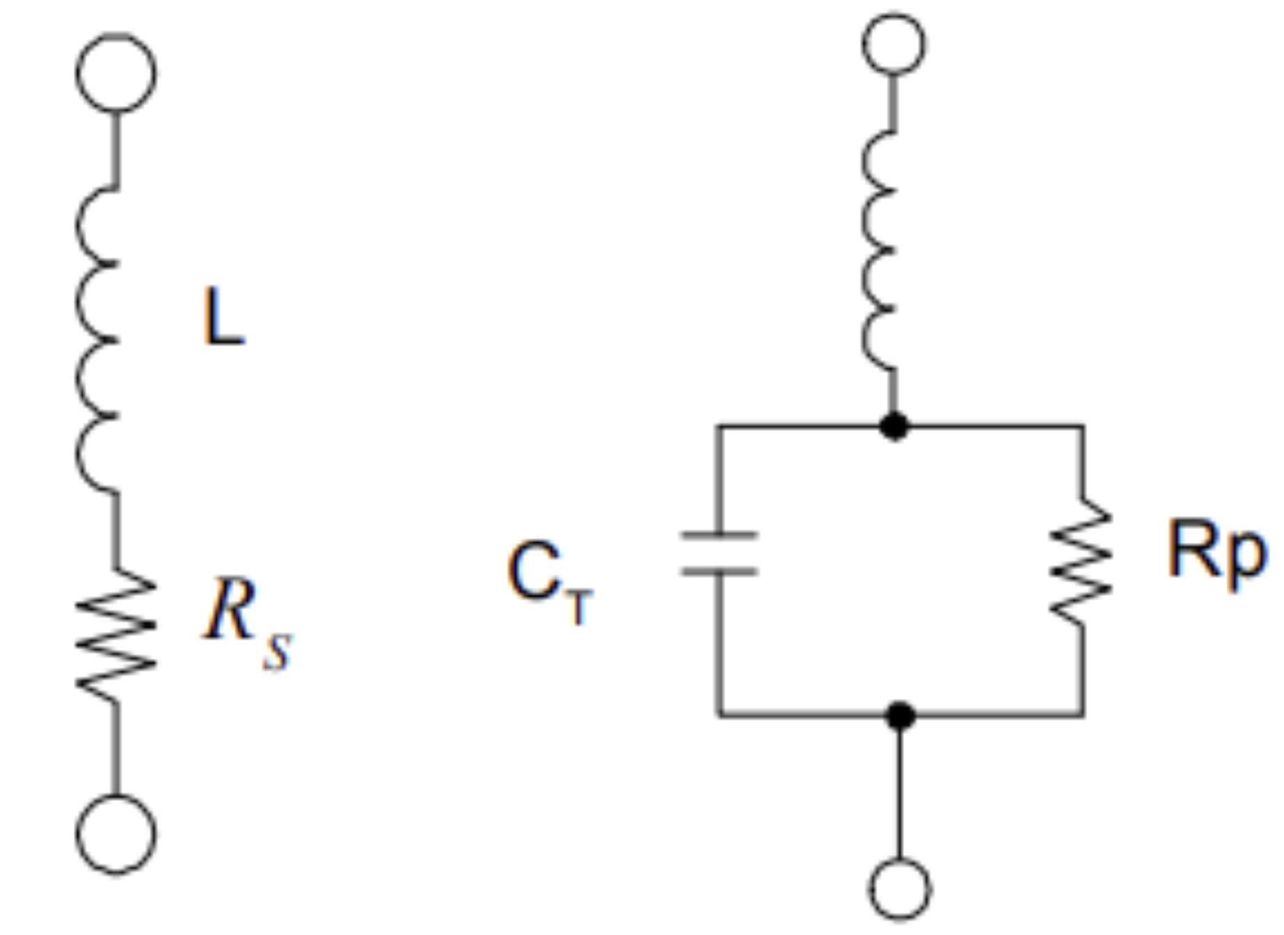
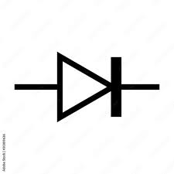
Diode Modeling (High Frequency)
When the diode is forward biased, it acts like a series inductor and resistor
When the diode is in reverse bias, it acts like a parallel resistor and capacitor (similar to a varactor)

Slide 6
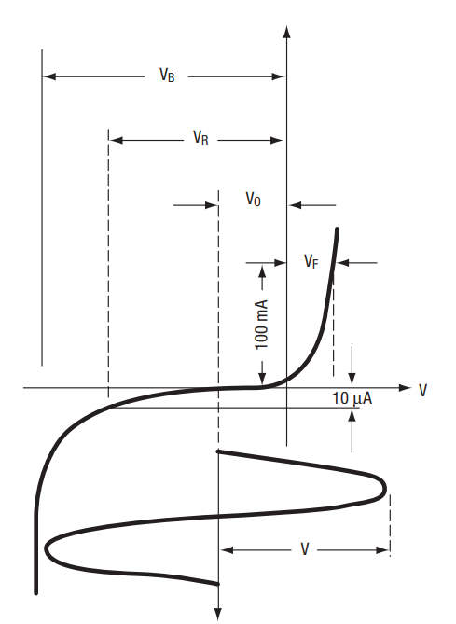
PIN Diodes
An Intrinsic layer is inserted in between the P and N regions of a typical diode
That intrinsic layer is lightly doped or not doped at all
This allows the junction to store extra charge which increases the reverse recovery time of the diode significantly
This means that the diode can conduct in both directions provided the stored charge is not depleted
i.e. either the frequency needs to be high enough or there need to be enough bias current

Slide 7


PIN Diode Forward Bias
The PIN diode acts as a current controlled resistor in forward bias
Also acts like a voltage controlled capacitor in reverse bias
$$R_{s}=\frac{W^{2}}{\left(μ_{n}+μ_{p}\right)Q }=\frac{W^{2}}{\left(μ_{n}+μ_{p}\right)τI_{fwd}}, for f>\frac{1300}{W^{2}}$$
Where:
R_{s} is the series resistance of the PIN diode (Ω)
W is the width of the intrinsic region (µm)
f is the frequency of operation (MHz)
τ is the carrier lifetime
µ_{n} is the electron mobility
µ_{p} is the hole mobility

Slide 8

PIN Diode Applications
RF (High Frequency) Switches – great for switching large RF powers with small bias currents
Variable Attenuators (variable voltage dividers – controlled by bias current)
Modulators
Phase Shifters
Optical Detectors (used in fiber communication systems)

Slide 9
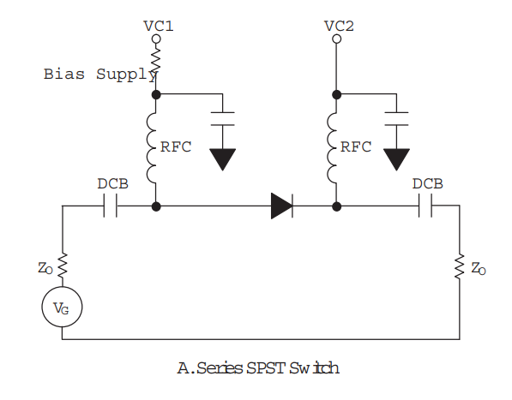
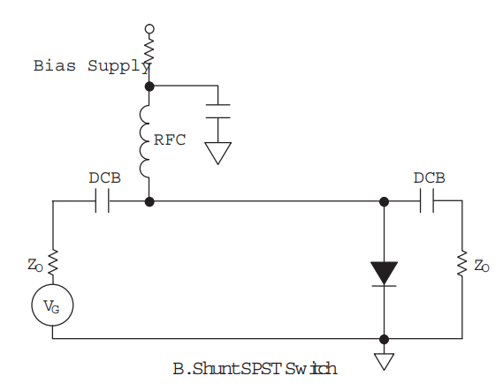
PIN Diode Switches
Diodes can either be used in series or in parallel (shunt)
These type of switches either transmit the signal or reflect it back
Isolation is a problem with series switches

Slide 10
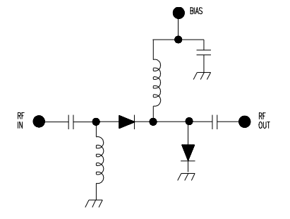
Compound Switches
Multiple diodes can be used to improve the isolation

Slide 11
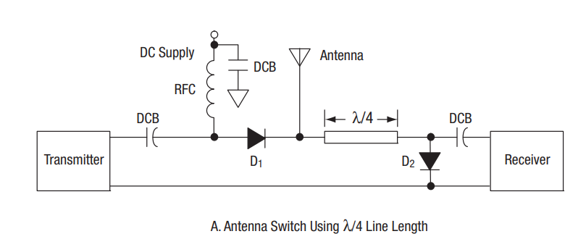
PIN Diode TX/ RX Switch Example
Single pole double throw
Quarter wave transformer is used to do impedance transformation

Slide 12
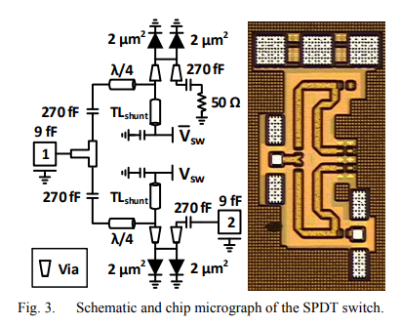
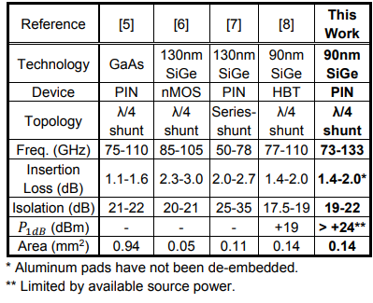
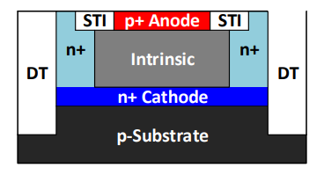
High Frequency Switch Example

Slide 13
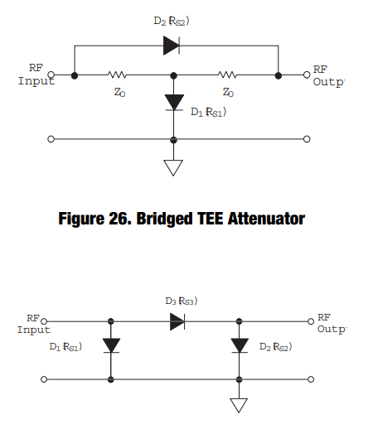
Matched PIN Diode Attenuators
An attenuator is just a voltage divider
Which is meant to add some loss in the circuit to make the voltages smaller at the output
Any PIN diode switch can be used as an attenuator, all that is needed is to control the bias current more finely
In the matched attenuator, each diode is biased at a different current level
The bias of each diode must track one another at all attenuation levels to maintain matching
The bias circuit is not shown

Slide 14
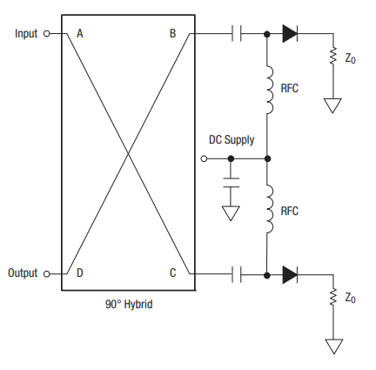
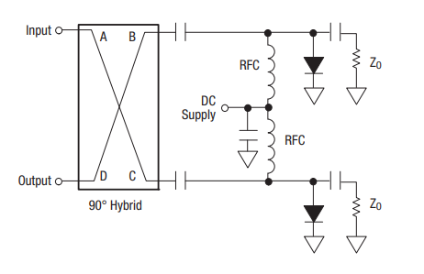
Tuned PIN Diode Attenuators
The matching is from the 90 degree hybrid (coupler)

Slide 15
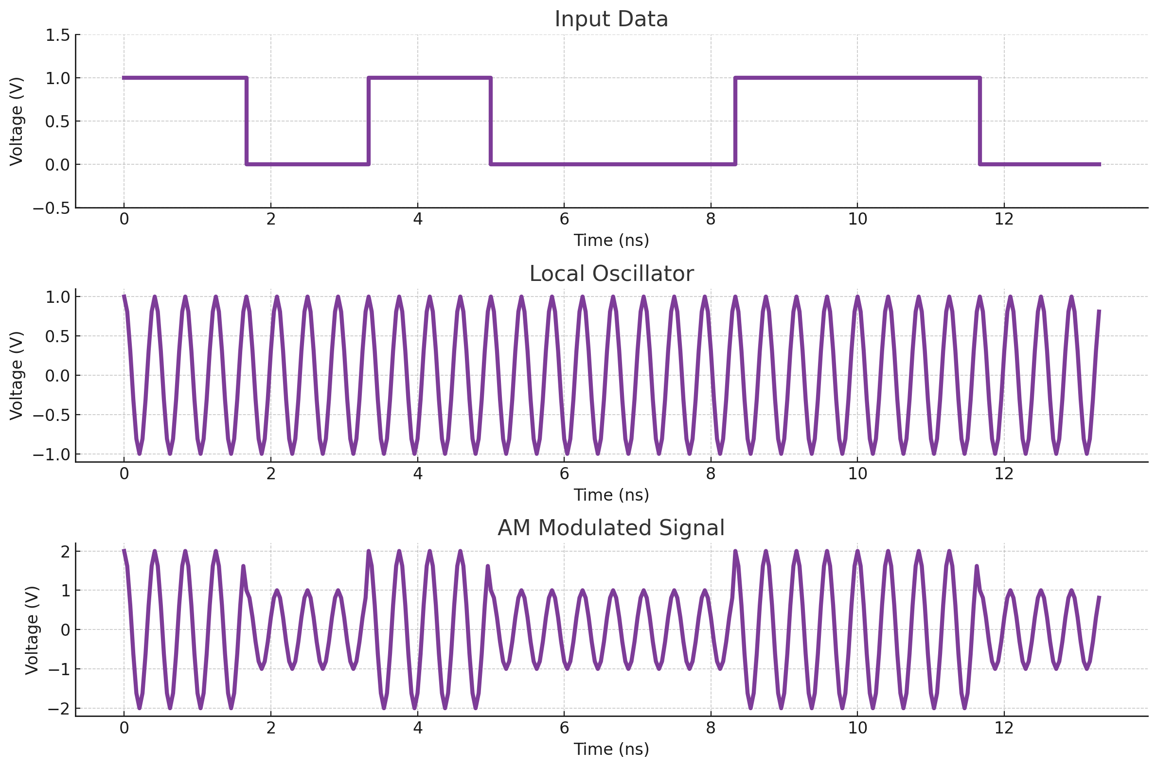
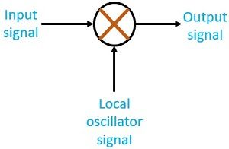

Modulators and Modulation
To modulate a signal, just use a multiplication bloack (called a mixer)
We modulate signals because it is easier to transmit higher frequency signals with antennas
$v_{out}\left(t\right)=(bias+data\left(t\right))∗V_{0}cos⁡(2πf_{0}t)$

Slide 16
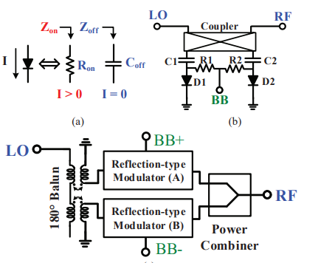
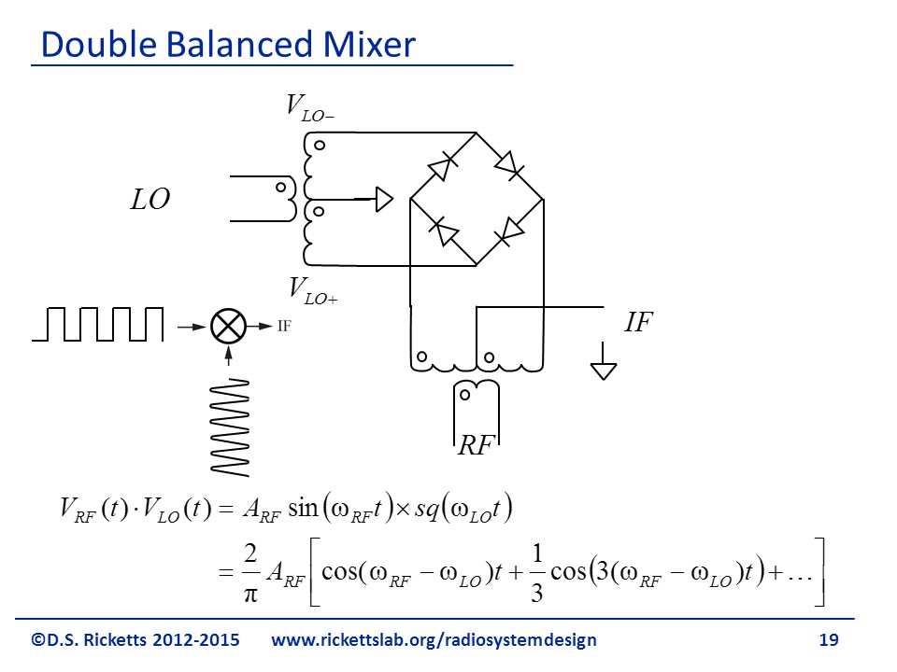
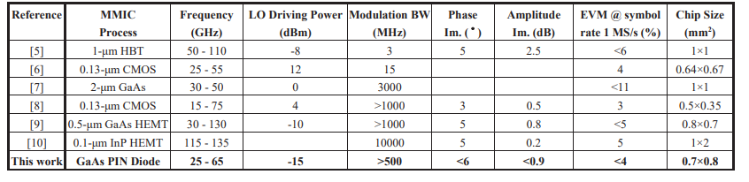
PIN Diode Modulators
Since the Rs of a PIN diode is a function of the bias current, this can be used for modulation
Modulation Bandwidth can be limited due to the (relatively long reverse recovery time)

Slide 17
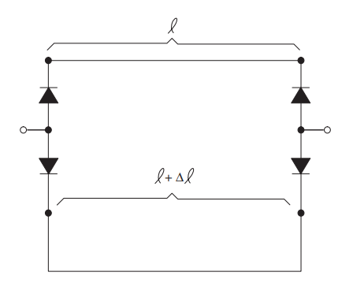
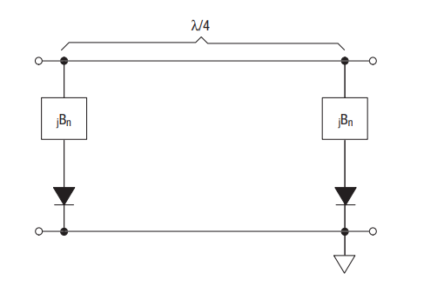
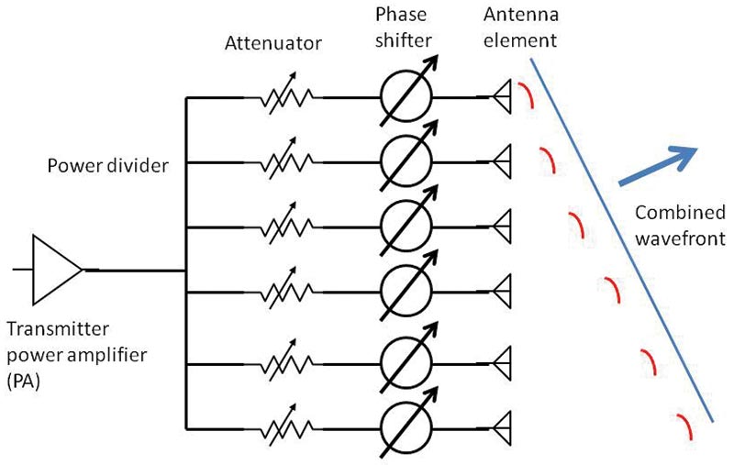
PIN Diode Phase Shifters
A phase shifter is a device that introduces some phase shift into a circuit/ signal
Idea is to introduce some switched in reactive element to provide some phase shift
Delay lines also work
If we have an array of antennas, adding phase shifts can steer the beam

Slide 18
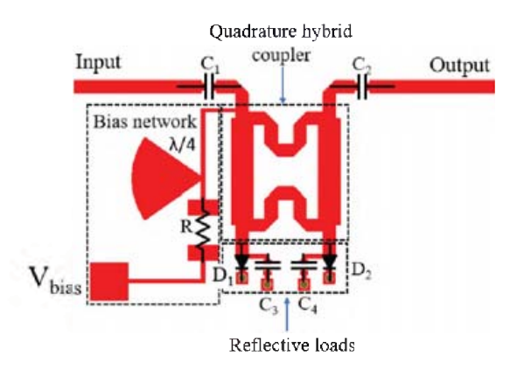
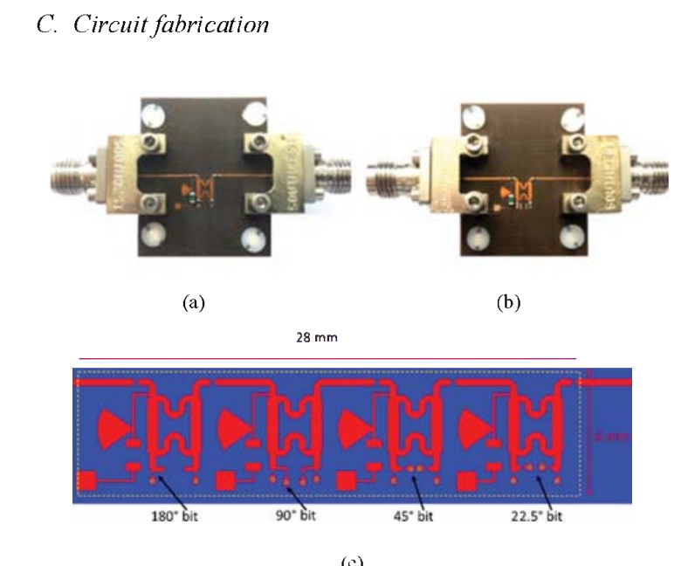
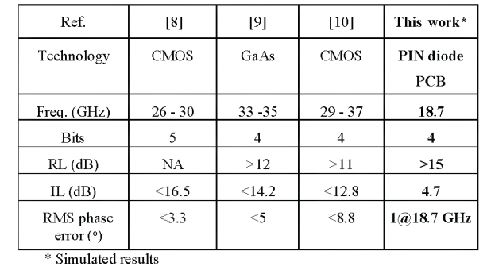
Phase Shifter Example

Slide 19
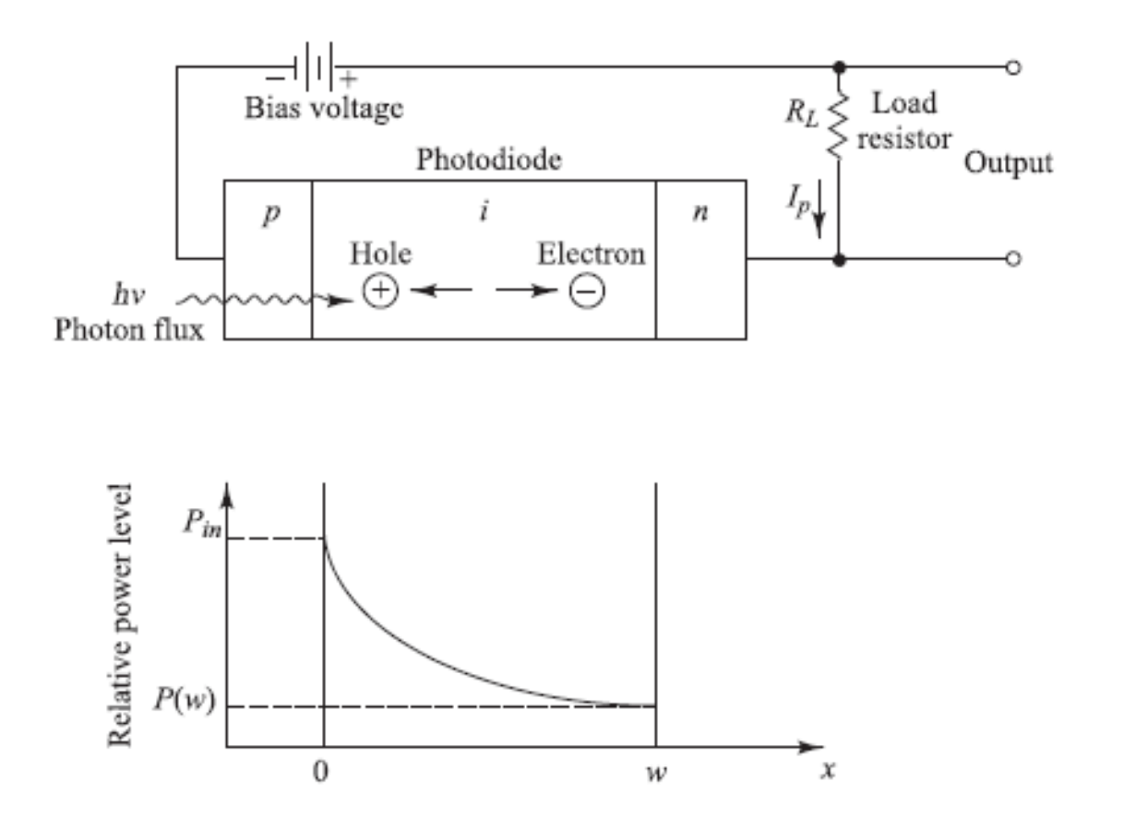
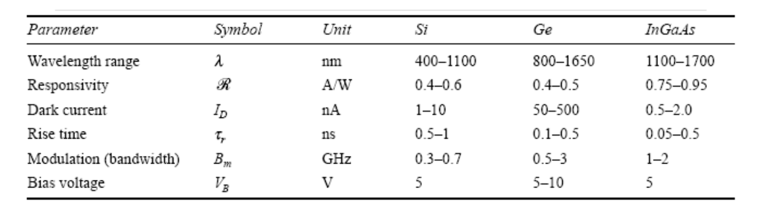
PIN Diode Detectors

Slide 20
PIN Diode Advantages
Ruggedness and High Reliability: Capable of withstanding high voltage and current peaks and thermal impulses.
High Voltage and Current Capabilities: Suitable for applications requiring voltages greater than 2000 volts and continuous currents exceeding 25 amperes.
High Surge Current Capability: Can handle surge currents over 500 amperes for short durations.
Low Distortion: Exhibits less than -60dBc distortion at 455 KHz.
High Power Gain: Offers a power gain exceeding 10,000:1.
Switching Speed: Capable of switching speeds under 100 ns, depending on construction.
Compact Size: Its small physical size makes it ideal for various applications.
Variety of Thermal Packaging Options: Offers flexibility in thermal management.
RF Relay Replacement: Can replace mechanical (sometimes Hg containing) relays in RF applications.

Slide 21
PIN Diode Disadvantages
Isolation: Since there is parasitic capacitance in the junction, there will always be some level of leakage when the diode is isolating two different circuits which is usually more than an RF relay, but it really depends on the devices that are being used
Repeatability: The PIN diode is not as repeatable as the RF relay
Maximum Power/ Voltage: The PIN diode does have a maximum power and voltage ratings, which are typically lower than an RF relay
Switching Speed: The reverse recovery time limits the switching speed of the PIN diode. In high speed applications, not all PIN diodes will be acceptable

Slide 22
Questions?

Slide 23
References
W. E. Doherty and R. D. Joos, The Pin Diode Circuit Designers’ handbook , https://www.qsl.net/n9zia/pdf/pin_diode_handbook.pdf (accessed Nov. 21, 2023).
Skyworks Solutions, Inc., Application note design with PIN diodes , https://www.digikey.com/Site/Global/Layouts/DownloadPdf.ashx?pdfUrl=AF319B62D6FD4AD182C38082595F3B28 (accessed Nov. 21, 2023).
H. Phuong Thao, T. Van Son, N. Van Doai, N. Trong Duc and V. V. Yem, "A novel frequency reconfigurable monopole antenna using PIN diode for WLAN/WIMAX applications," 2015 International Conference on Communications, Management and Telecommunications (ComManTel), DaNang, Vietnam, 2015, pp. 167-171, doi: 10.1109/ComManTel.2015.7394281.
P. Song, R. L. Schmid, A. Ç. Ulusoy and J. D. Cressler, "A high-power, low-loss W-band SPDT switch using SiGe PIN diodes," 2014 IEEE Radio Frequency Integrated Circuits Symposium, Tampa, FL, USA, 2014, pp. 195-198, doi: 10.1109/RFIC.2014.6851695.
X. Lin, H. -E. Liu, H. -Y. Chang and Y. -C. Wang, "A 25–65 GHz broadband low-LO-driving wide-modulation-bandwidth monolithic BPSK modulator in GaAs PIN diode MMIC process," 2017 IEEE Asia Pacific Microwave Conference (APMC), Kuala Lumpur, Malaysia, 2017, pp. 910-913, doi: 10.1109/APMC.2017.8251597.
K. T. Trinh, J. Feng and N. C. Karmakar, "18.7 GHz 4-Bit PIN Diode Reflection Type Phase Shifter for Radiometer Phased Array Antenna," 2021 2nd International Conference on Robotics, Electrical and Signal Processing Techniques (ICREST), DHAKA, Bangladesh, 2021, pp. 504-509, doi: 10.1109/ICREST51555.2021.9331208.
System, “Si Pin diode,” Home, https://www.macom.com/products/product-detail/MA4FCP200 (accessed Nov. 20, 2023).

